Slide 1
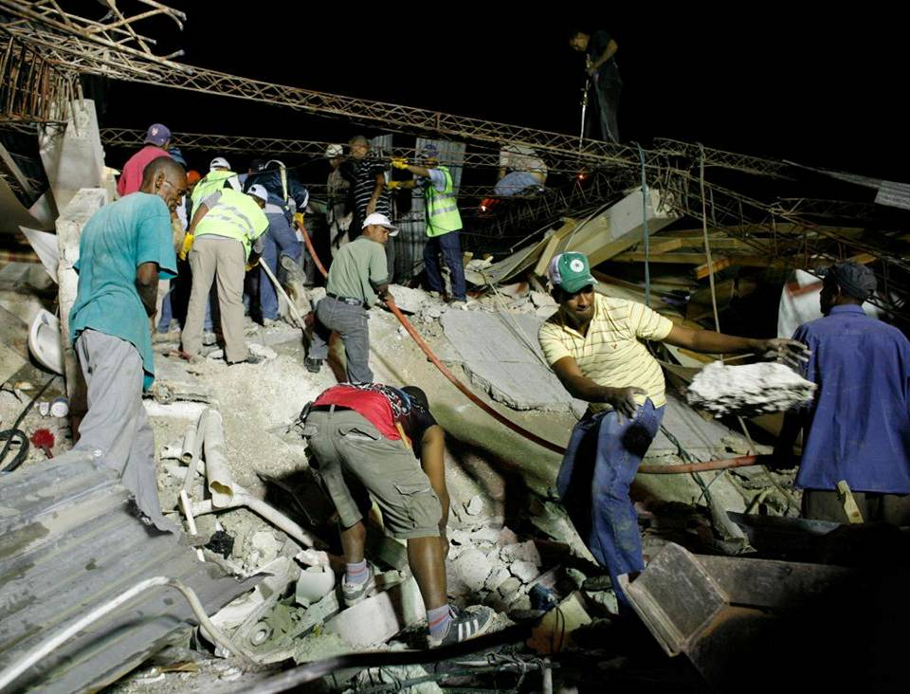
Community work to expose lower debris levels

